Slide 1

Traffic Sign Classifier Submitted by: Vaibhav Kumar Kapriyal University Roll No.: 2018837 Class Roll. No./Section: 59/A
Mini Project

Slide 2
Project Overview
Object identification has many applications in various fields. This project aims to identify a traffic sign from a
Digital image. This would be useful in an autonomous vehicle application. These ideas and methods could also be used in other areas.
The overall objective of this project is to write a program what will identify a traffic sign from a digital photograph.
Traffic signs appear in diverse background situations and, at times, may be partially obscured.

Slide 3
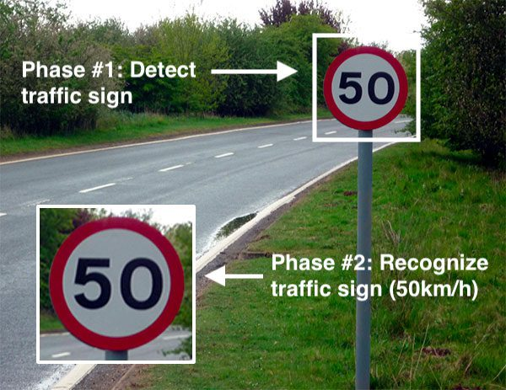
Introduction
Traffic sign classifier have received an increasing interest in the last few years. This is due to the wide range of applications that a system with this capability provides, like driving assistance system.
This is an attempt to make a self learning system that can itself understand and interpret the meaning of new traffic signs.

Slide 4
Tools Dataset And Software Used ooland software used
1.opencv
2.numpy
3.scikit-learn/ scikit-image
4.os
5.matplotlib
6. Tensorflow 2.0
The dataset we’ll be using to train our own custom traffic sign classifier is the German Traffic Sign Recognition Benchmark (GTSRB).
The GTSRB dataset consists of 43 traffic sign classes and nearly 50,000 images.
For coding purpose IDLE Python was used and code was written using Python language.

Slide 5
Steps to Build the Python Project
Our approach to building this traffic sign classification model is discussed in four steps:
Explore the dataset
Build a CNN model
Train and validate the model
Test the model with test dataset

Slide 6
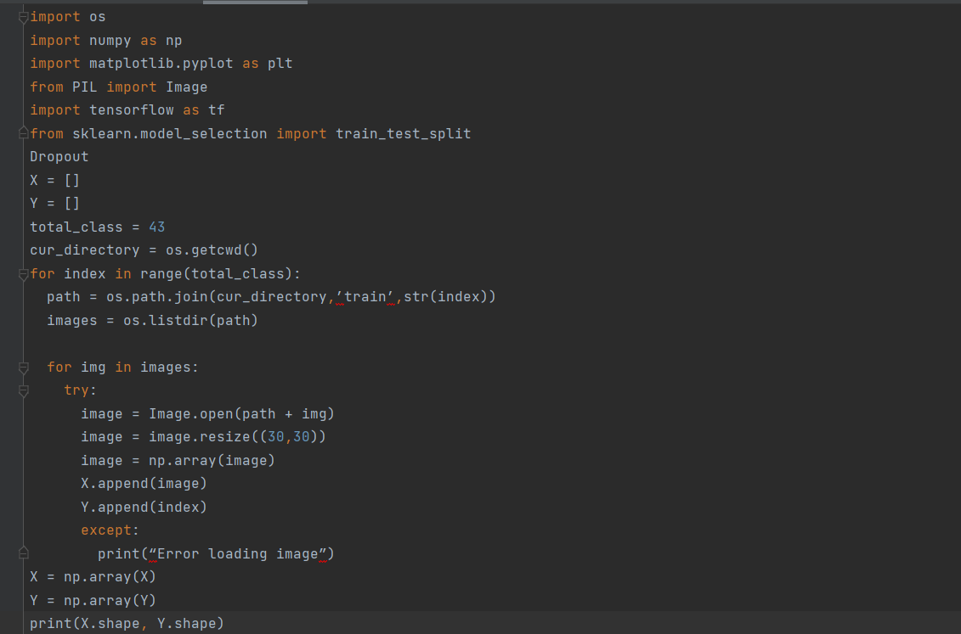
Step 1: Explore the dataset
Our ‘train’ folder contains 43 folders each representing a different class. The range of the folder is from 0 to 42. With the help of the OS module, we iterate over all the classes and append images and their respective labels in the data and labels list.

Slide 7
Step 2: Build a CNN model
To classify the images into their respective categories, we will build a CNN model (Convolutional Neural Network). CNN is best for image classification purposes.
The architecture of our model is:
2 Conv2D layer (filter=32, kernel_size=(5,5), activation=”relu”)
MaxPool2D layer ( pool_size=(2,2))
Dropout layer (rate=0.25)

Slide 8
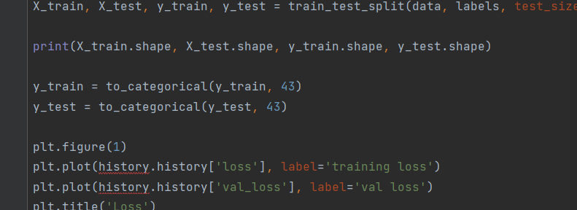
Steps 3: Train and validate the model
After building the model architecture, we then train the model using model.fit(). I tried with batch size 32 and 64. Our model performed better with 64 batch size. And after 15 epochs the accuracy was stable.

Slide 9
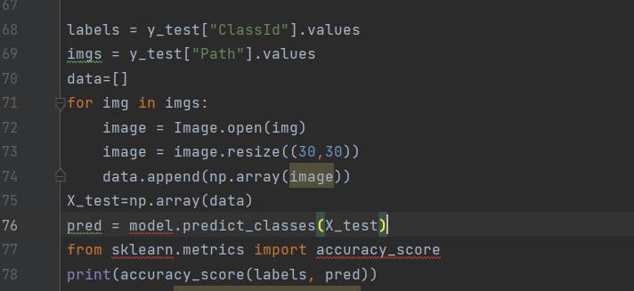
Step 4: Test our model with test dataset
Our dataset contains a test folder and in a test.csv file, we have the details related to the image path and their respective class labels. We extract the image path and labels using pandas. Then to predict the model, we have to resize our images to 30×30 pixels and make a numpy array containing all image data. From the sklearn.metrics, we imported the accuracy_score and observed how our model predicted the actual labels.

Slide 10

THANK YOU

